Slide 1
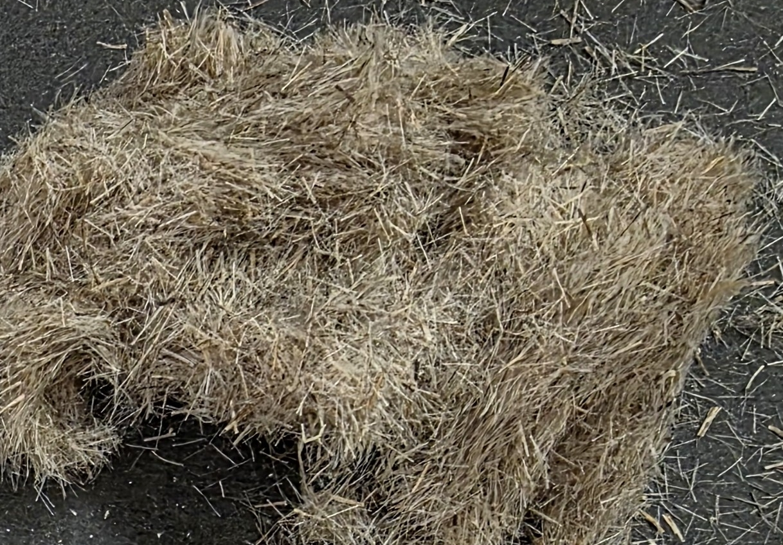
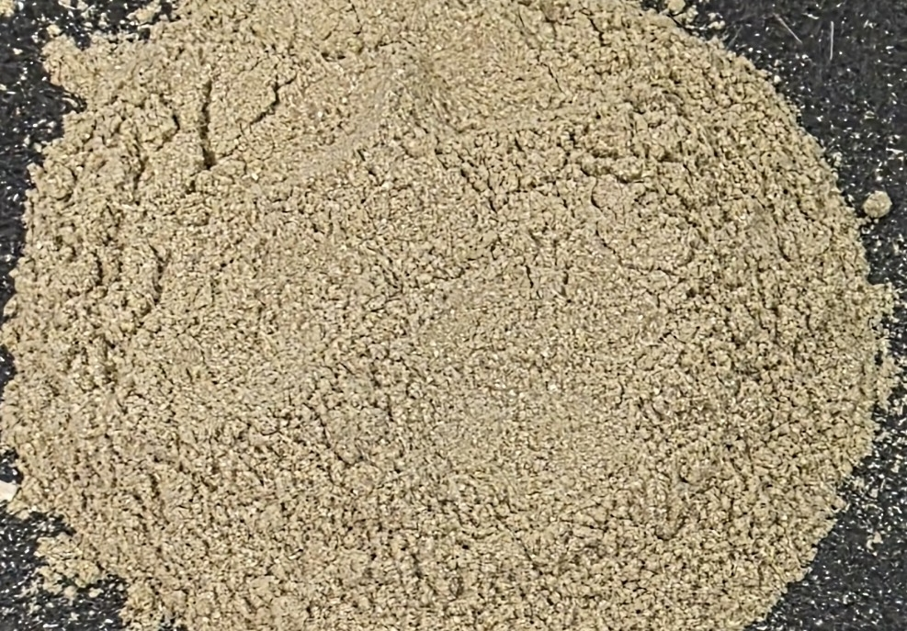
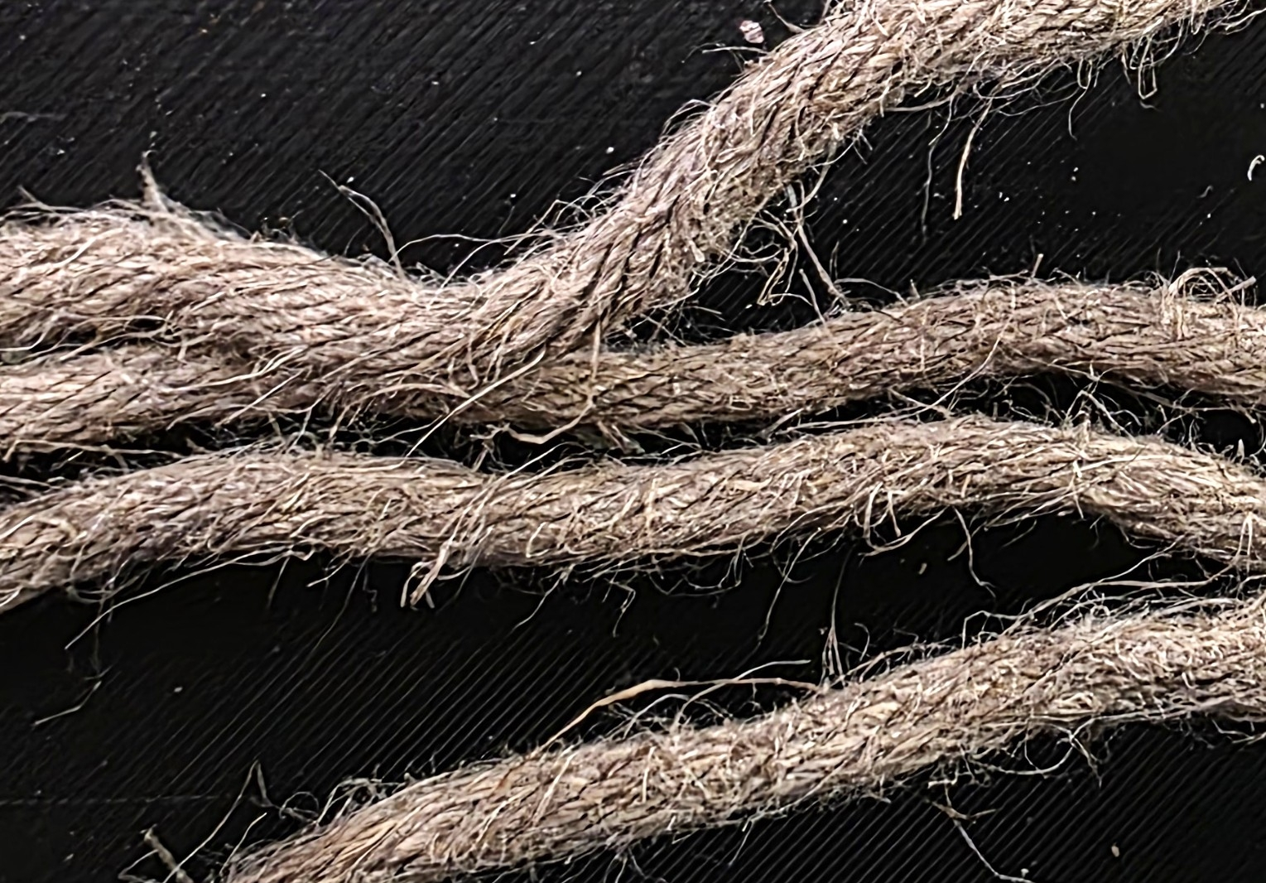

Hemp Reinforcement for Improved Strength of Wood Sodium Silicate Composites for Additive Manufacturing
Major Professor
Dr. Michael Maughan
Committee
Dr. Armando McDonald,
Dr. Daniel Robertson,
Dr. Ahmed Ibrahim
-Nagendra Tanikella
Funding: National Science Foundation

Slide 2
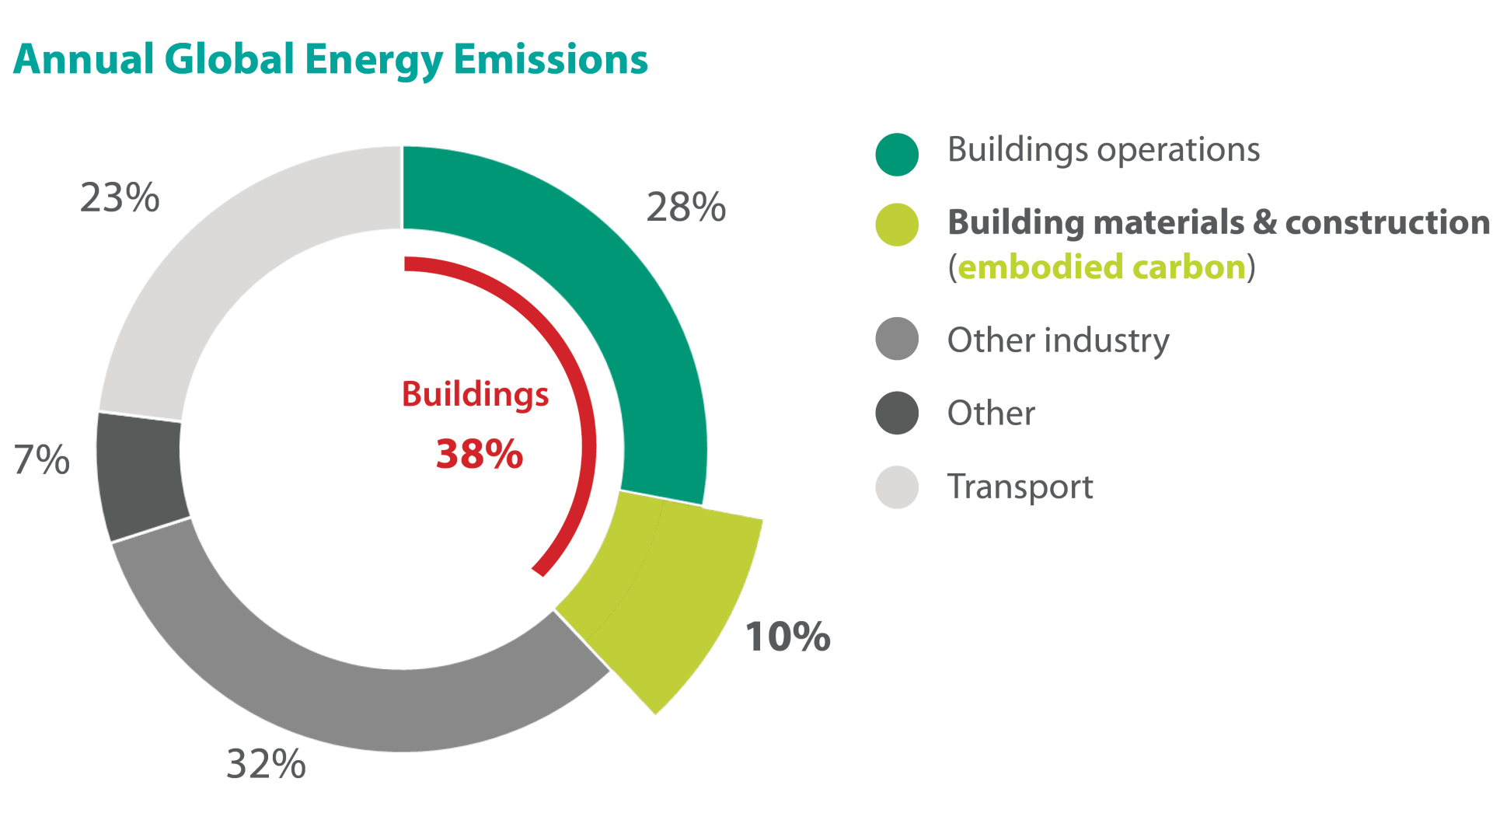
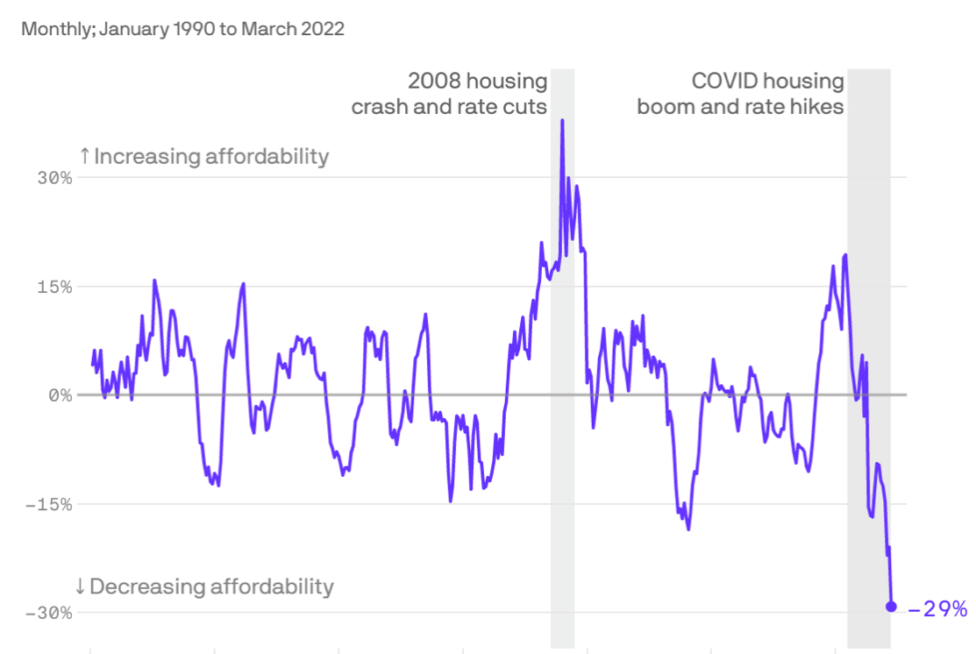
The construction industry faces a dual crisis of environmental impact and economic unaffordability
2020 Global Status Report for Buildings and Construction Sector | UNEP - UN Environment Programme
https://www.axios.com/2022/06/07/housing-affordability-collapse

Slide 3
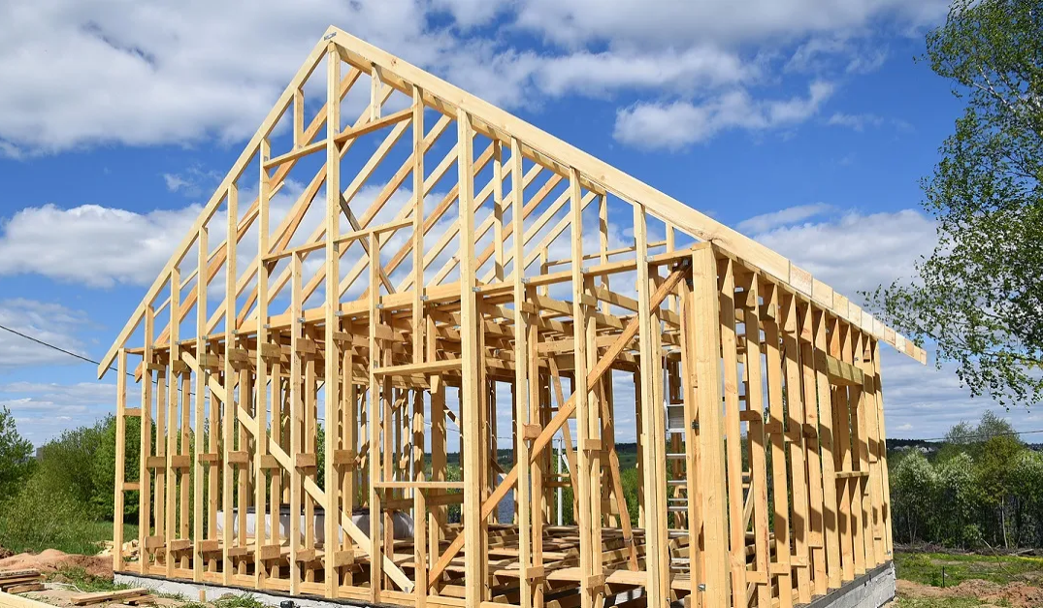
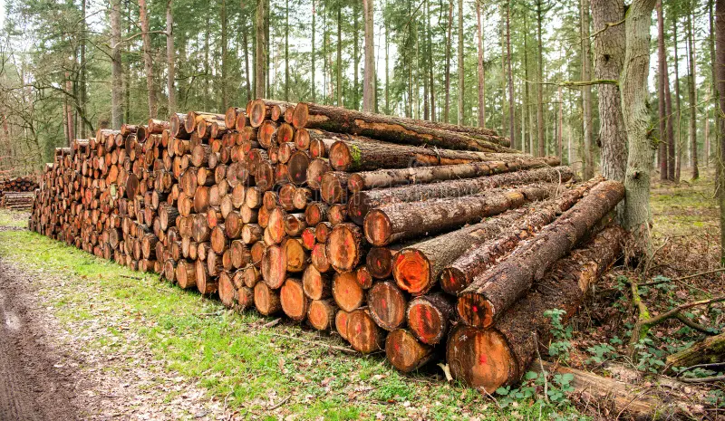
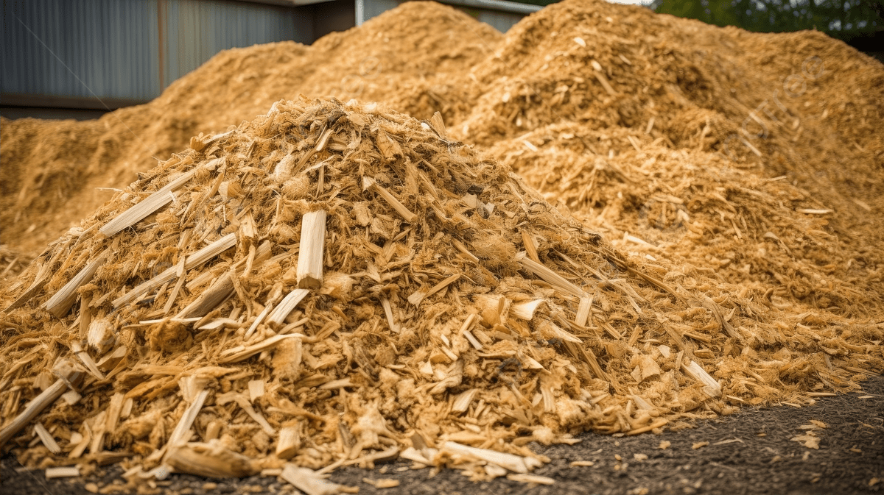
Lumber mills convert only about 40% of wood volume to lumber
40%
https://www.illinoisrealtors.org/wp-content/uploads/2020/06/house-frame-1200x630-1.jpg
https://www.shutterstock.com/image-photo/tree-log-forest-pine-softwood-lumber-2664366591?
60%
https://pikbest.com/backgrounds/wood-image-an-of-pulp-and-chips_9441013.html

Slide 4
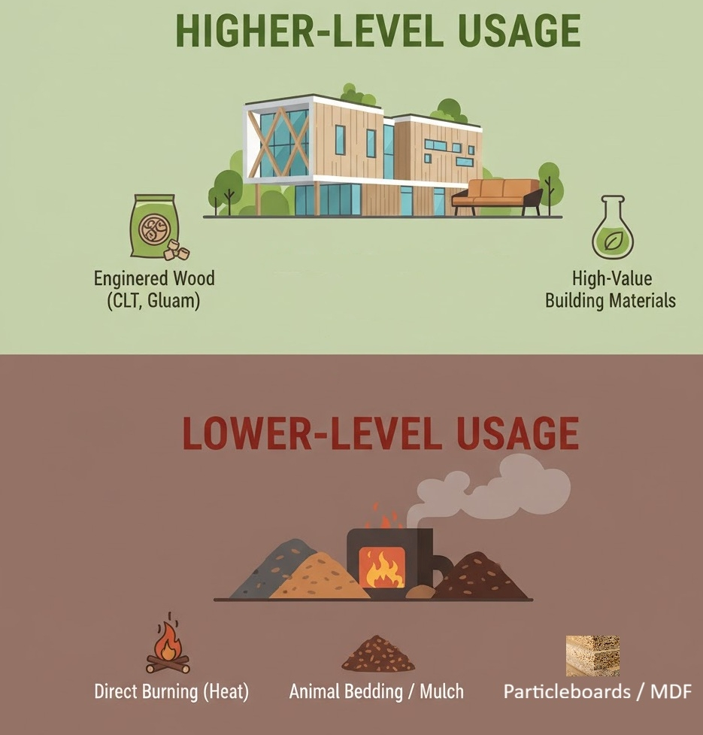
Wood residues are being utilized at a lower-level

Slide 5

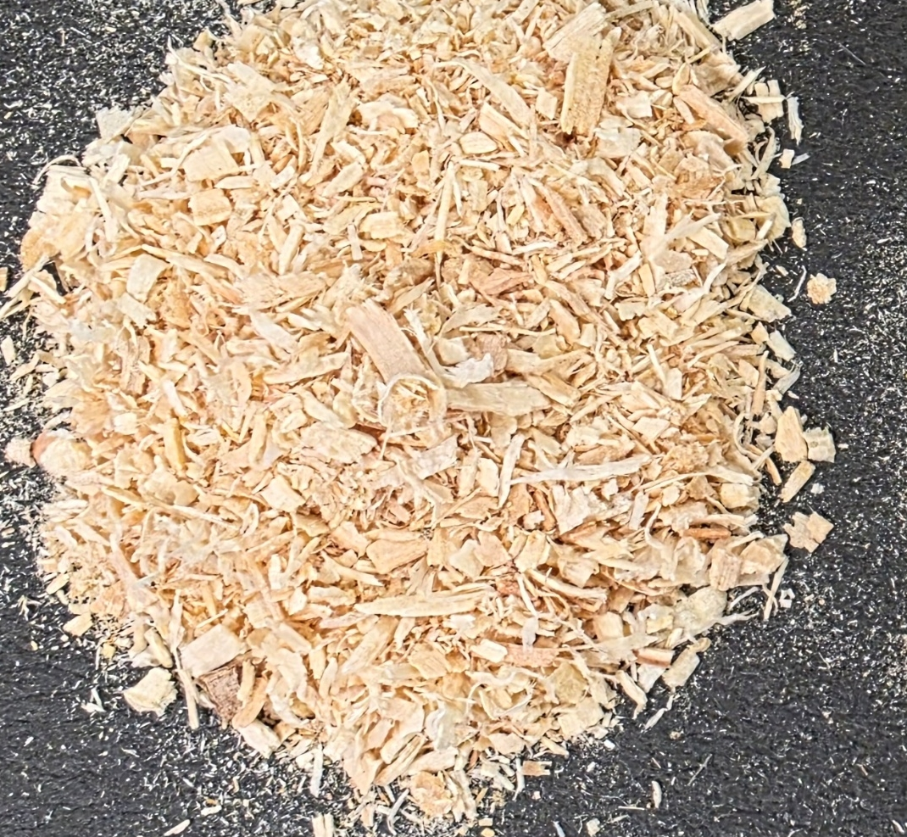
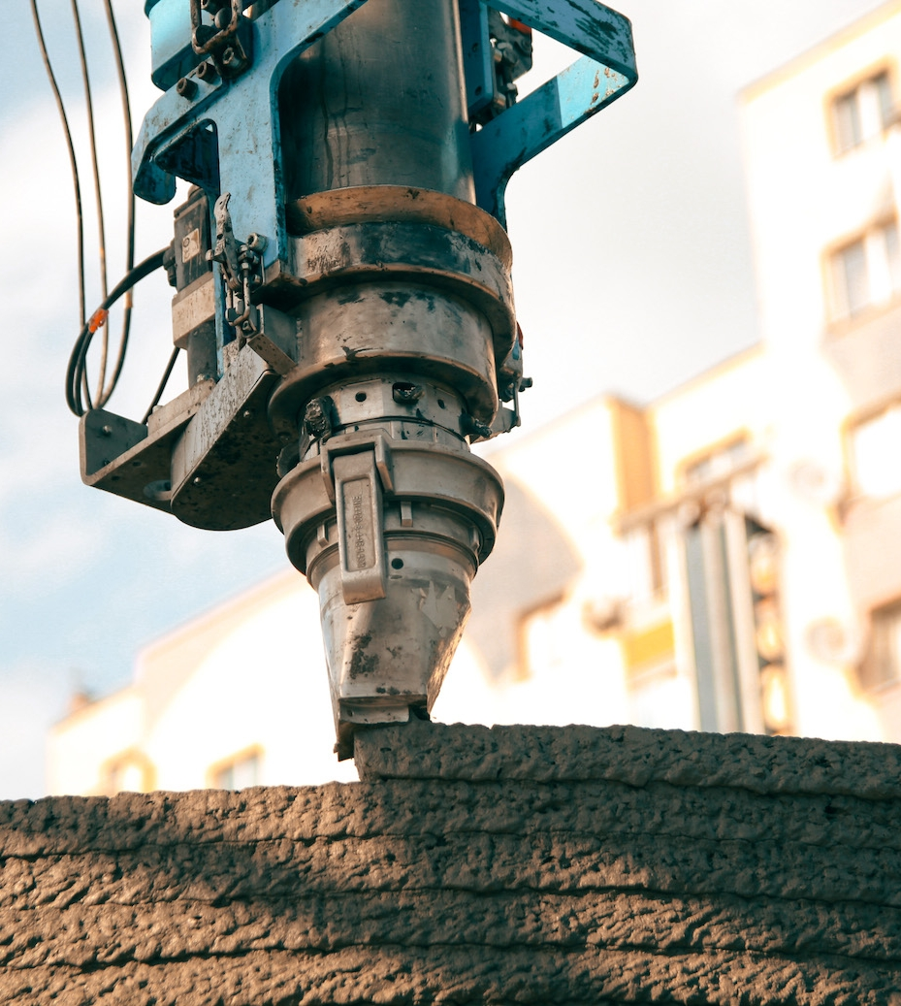
Our solution combines sustainable materials (wood waste) with an additive manufacturing process (AM)
https://www.3dnatives.com/de/groesstes-3d-druckgebaeude-der-welt-qatar-100720251/
2024 Global Status Report for Buildings and Construction Sector | UNEP - UN Environment Programme

Slide 6
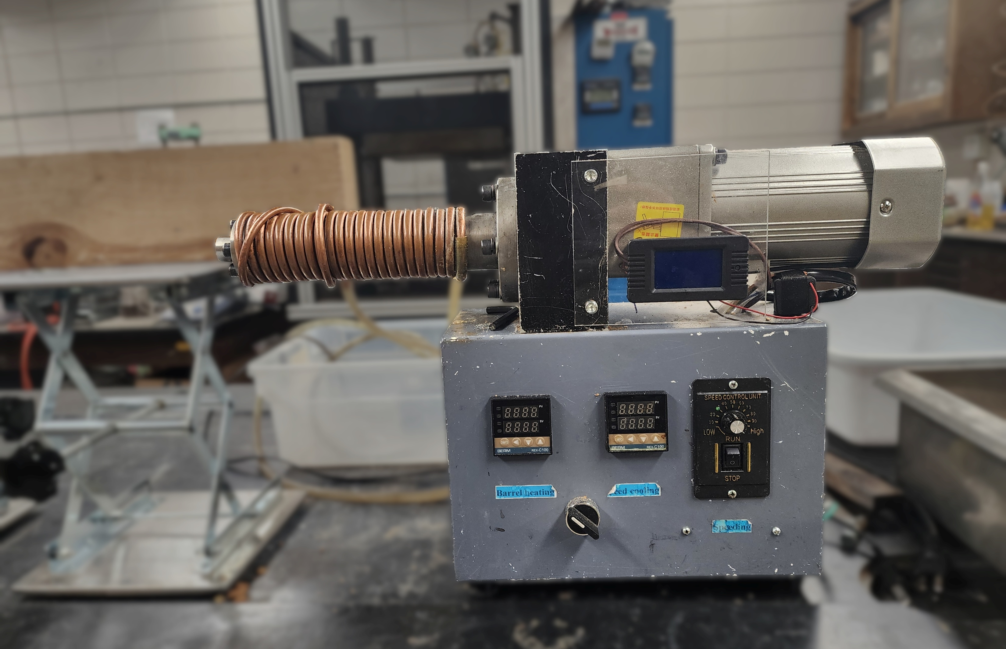
The method involves using a single screw extruder connected to a custom 3D printer

Slide 7
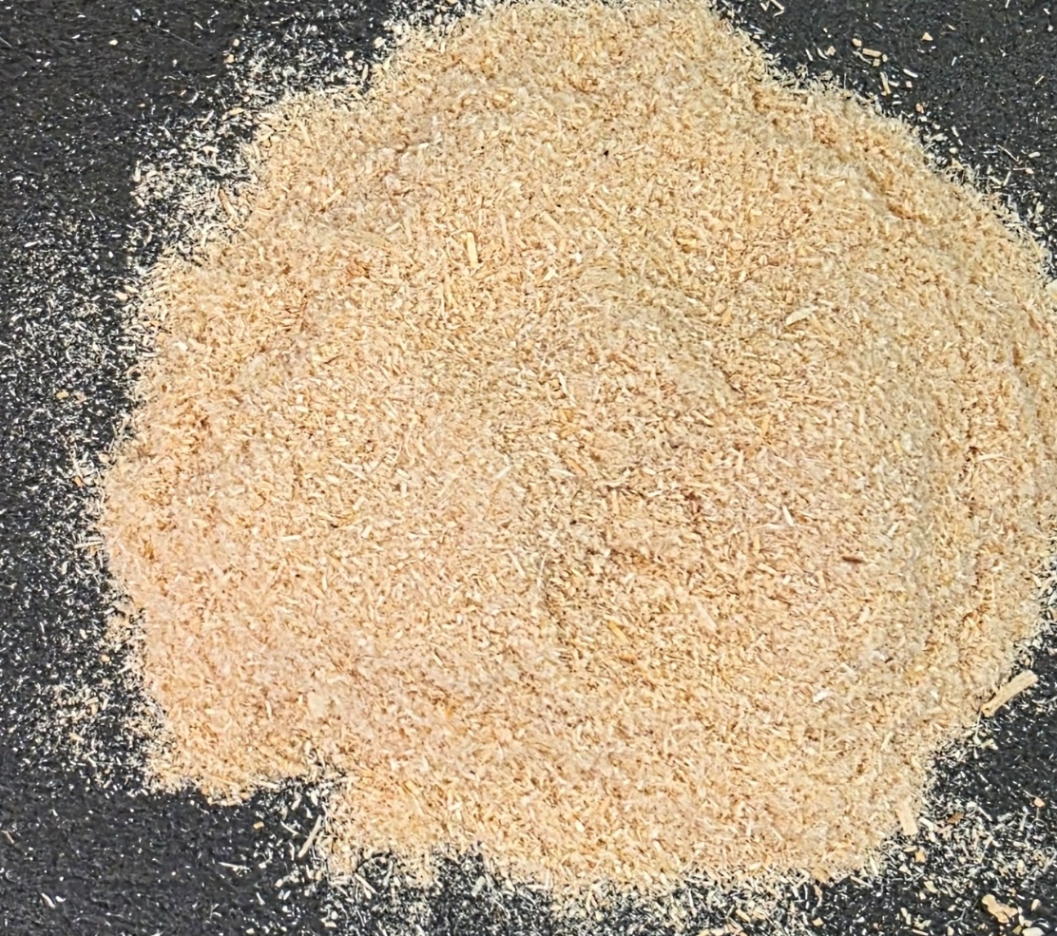
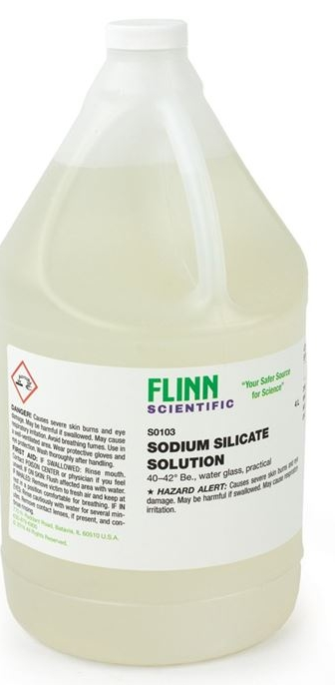
The baseline formulation is 40-mesh wood fibers with sodium silicate (WSSC) in a 50-50 ratio (dry basis)
Property | Typical WSSC values
Compression strength | 15-20 MPa
Tensile strength | 5-6 MPa
50-50
https://doi.org/10.1177/16878132231210373
https://www.flinnsci.com/sodium-silicate-solution-4-l/s0103/

Slide 8
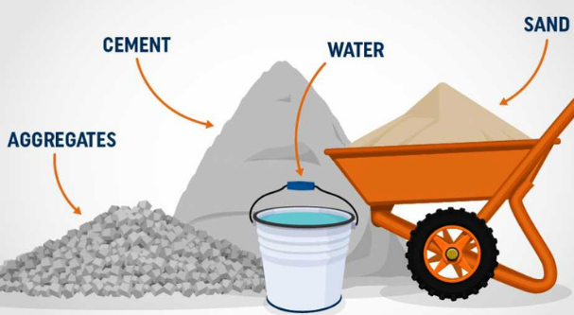
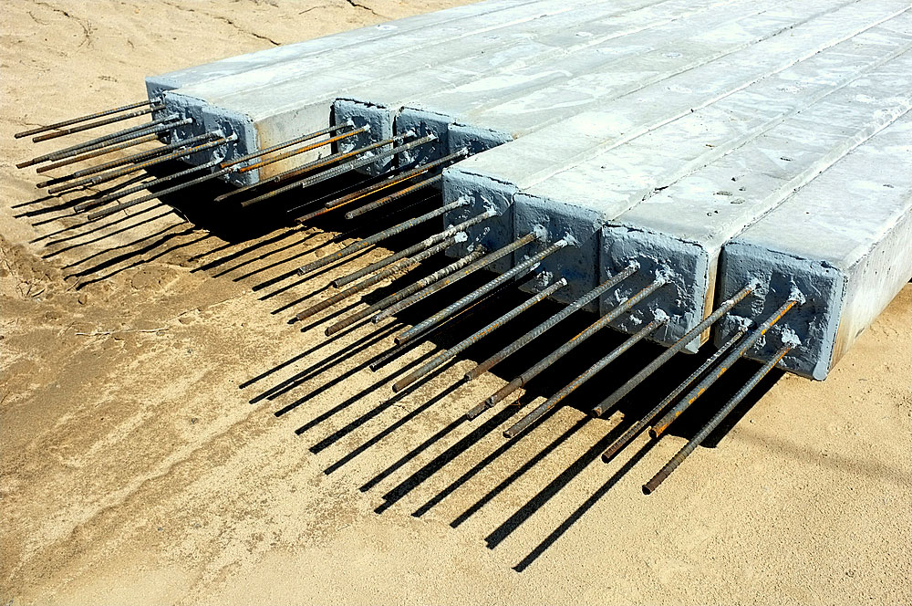
Concrete is reinforced with steel rebar for tensile strength and aggregates for cost/compression strength
https://www.ecc-edu.net/en/service/tutoring/details/reinforced-concrete-2
https://www.shutterstock.com/image-photo/contractors-lay-down-area-storage-precast-98231729

Slide 9
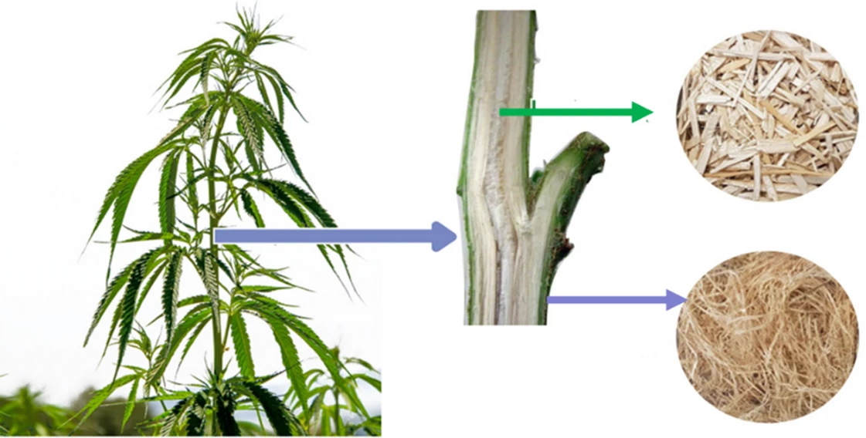
Hemp is a rapidly renewable plant that requires less water, and land and produces more, stronger fibers than cotton
Hemp hurd
Hemp fiber
https://doi.org/10.1007/s10570-022-04583-w

Slide 10
The research is structured as three studies to develop an optimized, high-strength composite
Study 1. Feasibility of short hemp fiber reinforcement
Study 2. Incorporation of hemp hurd
Effect of particle size
Study 3. Continuous hemp fiber reinforcement
Tensile strength
Extrudability and printability
Compression and flexural strength
Optimization based on cost, strength, extrudability
Modification of the die

Slide 11
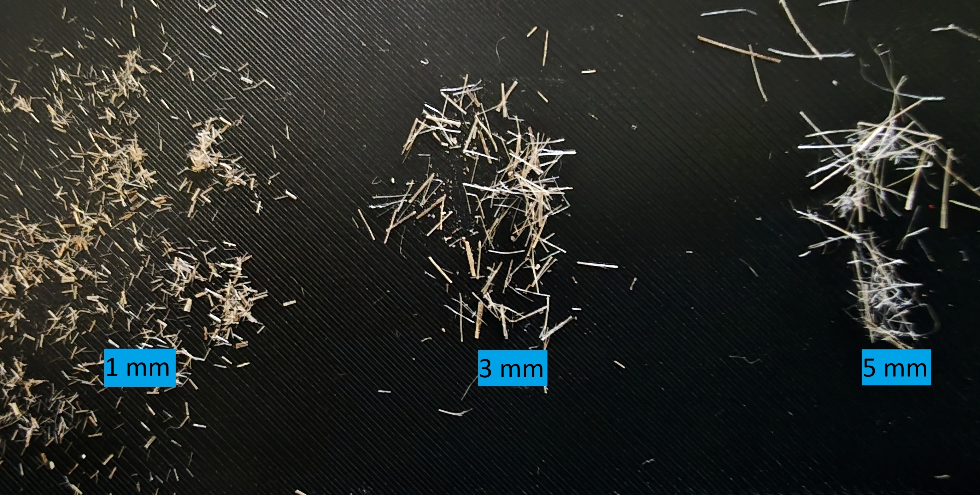
Study 1: Sodium silicate, hemp fiber amount and lengths were varied for experimental design
Variable materials | Levels
Sodium silicate (SS) (wt%): | 45-55
Hemp fiber (wt%): | 2.5-10
Hemp fiber (HF) lengths (mm): | 1-5

Slide 12
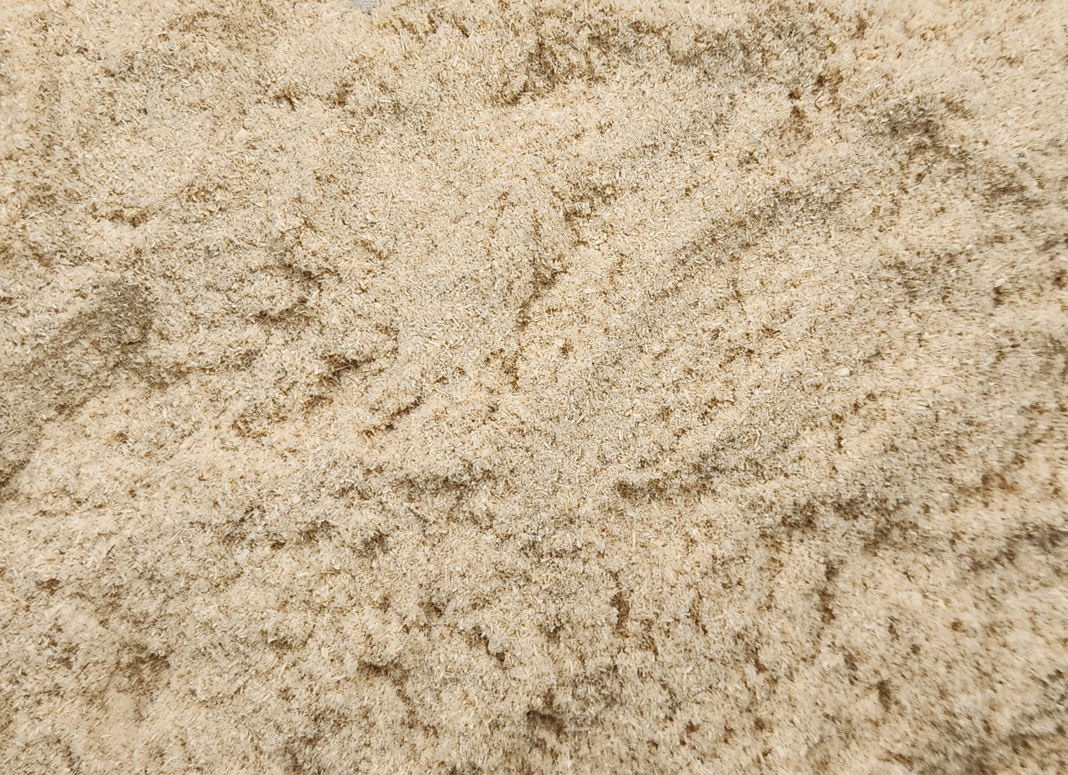
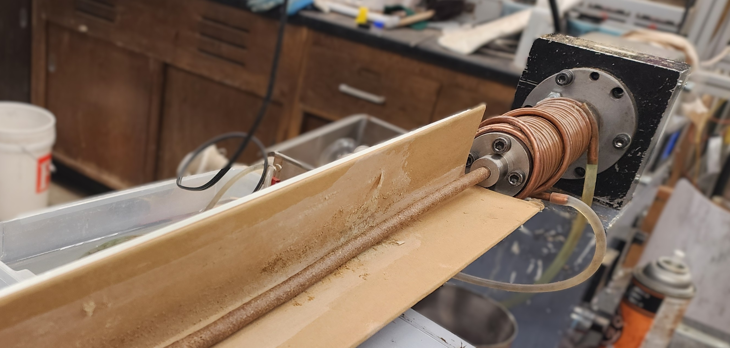
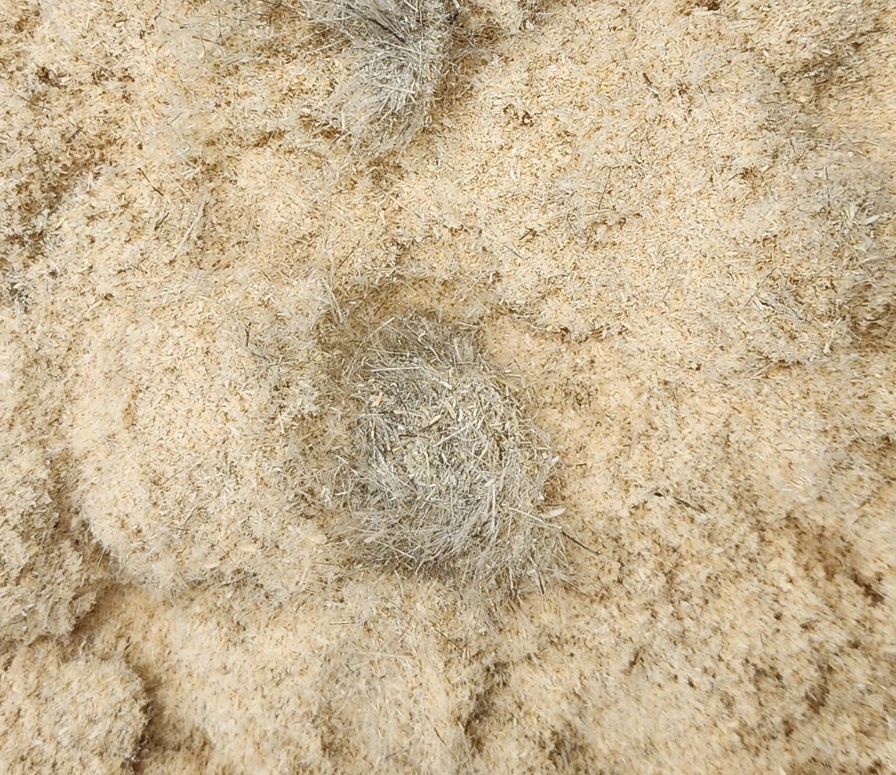
Longer fibers and low sodium silicate lead to processing issues and high motor power
1 mm
5 mm
Motor power (W) | Average extrusion time (min)
> 90 | 34
< 90 | 25
Clumps of fiber

Slide 13
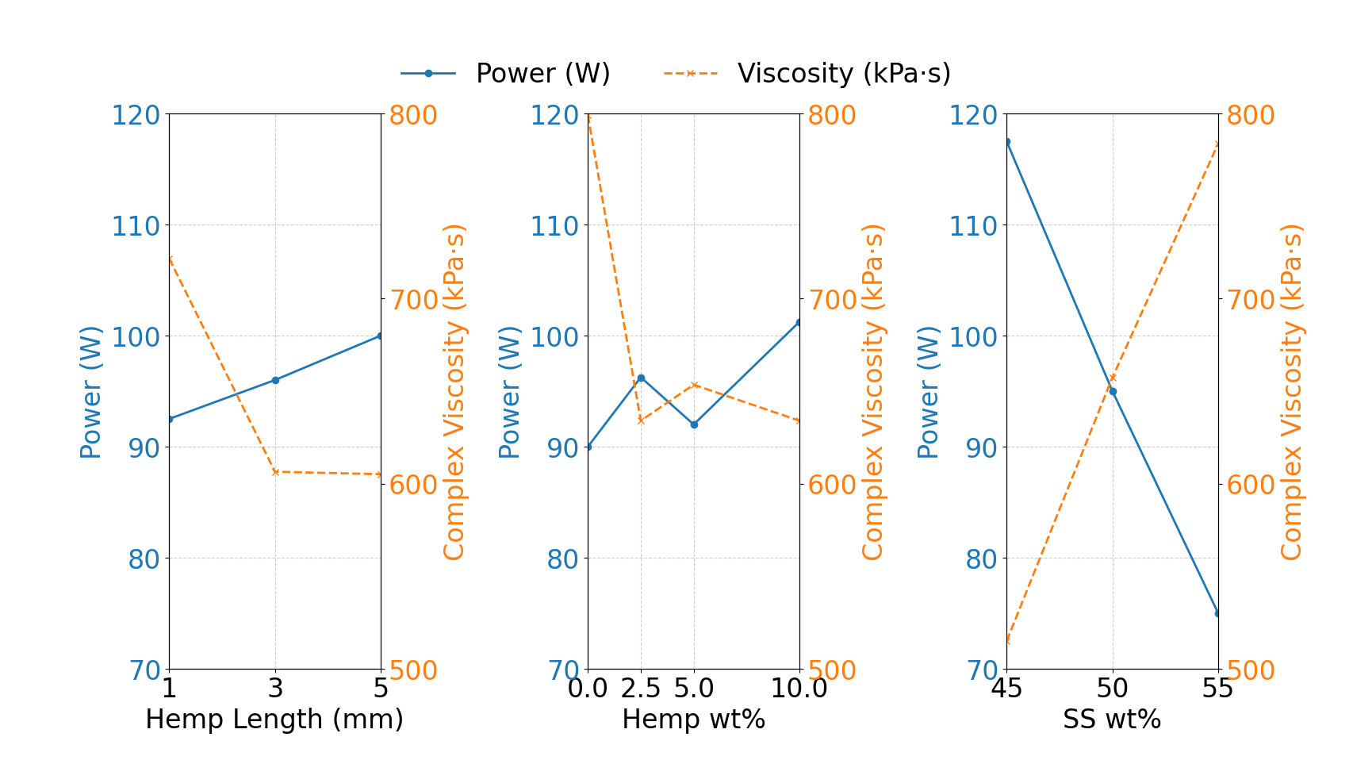
How did the factors affect motor power and viscosity?

Slide 14
How did the factors affect motor power?

Slide 15
How did the factors affect motor power?
p-values
0.314
0.539
0.01

Slide 16
How did the factors affect strength?

Slide 17
How did the factors affect strength?

Slide 18
Hemp fiber amount was the significant factor for improving mechanical strength

Slide 19
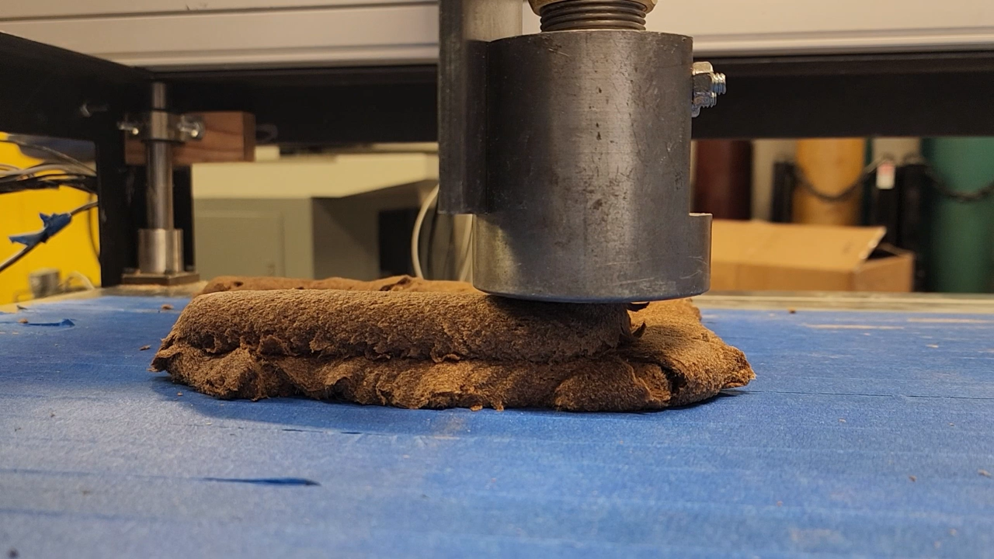
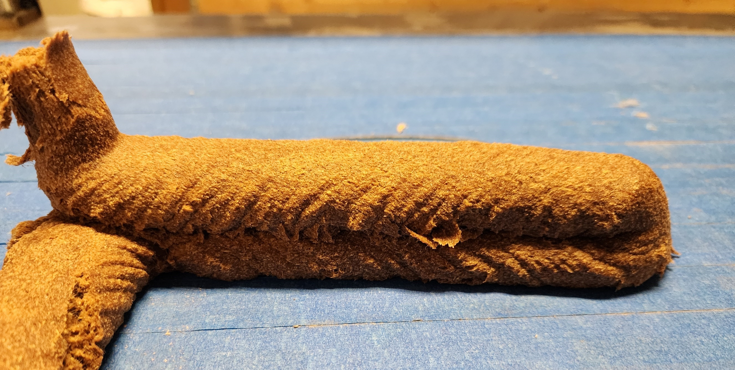
The formulation with 5% hemp fiber of 3 mm length, 50% sodium silicate was selected for 3D printing test
31%
36%

Slide 20
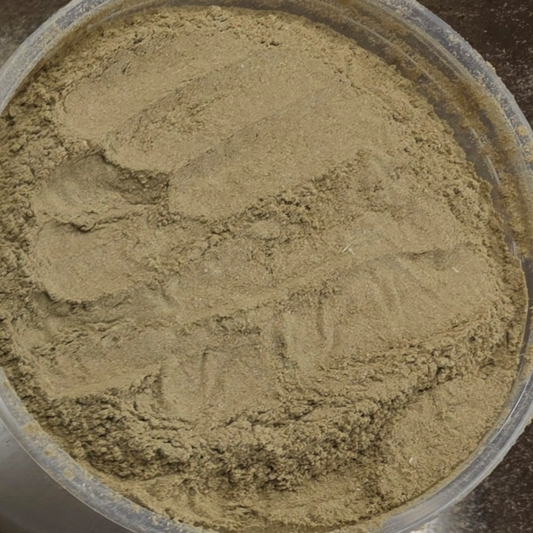
Study 2: Hemp hurd, sodium silicate were varied, along with the wood fibers for experimental design
Factor | Levels/Values
Hemp hurd (HH) (wt%) | 0-15
Hemp fiber (HF) (wt%) | Fixed at 5 (3 mm length)
Sodium silicate (SS) (wt%) | 50-60, 50 + 5Water
Wood fiber Type (WFT) | Unsifted, 40 mesh, pellet

Slide 21
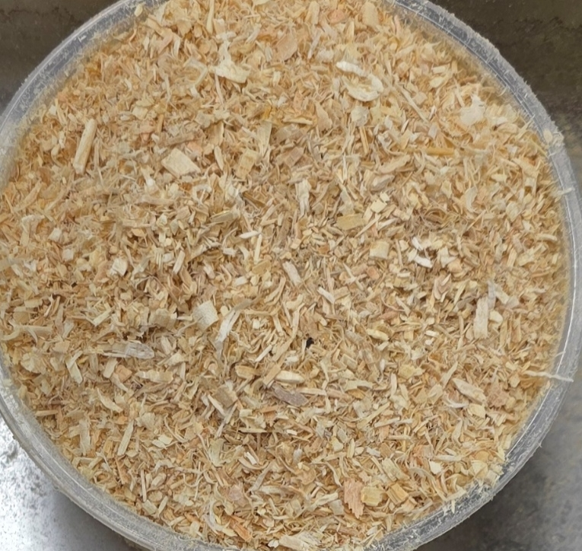
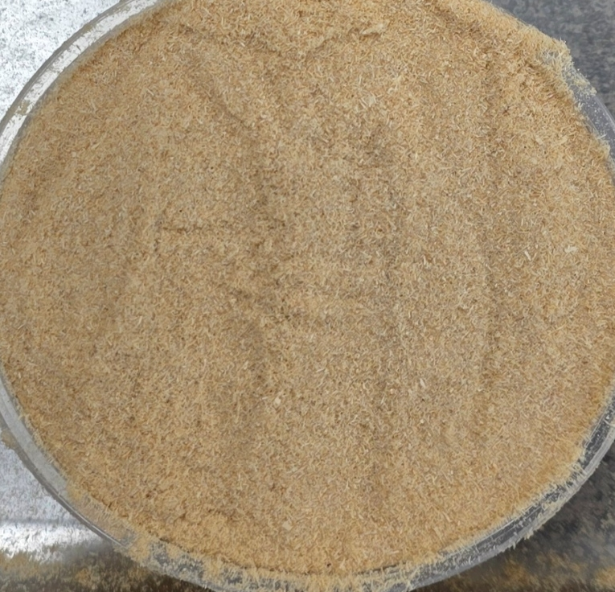
Wood fibers were sifted using a 40-mesh screen

Slide 22
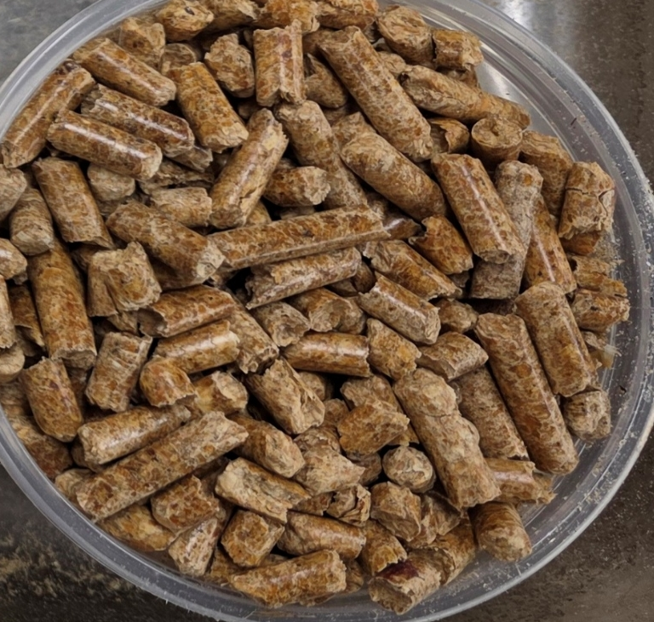
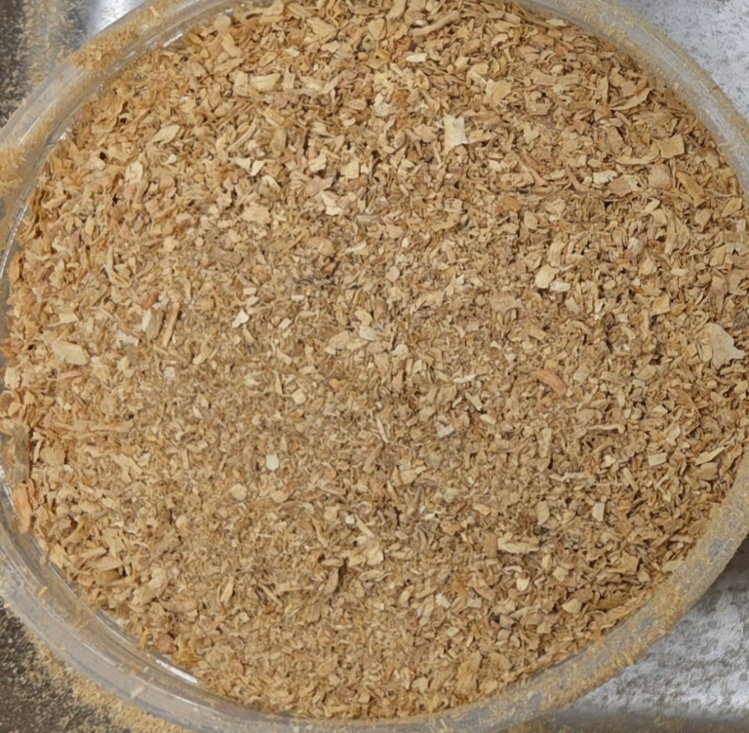
Wood pellets were ground using a coffee grinder before use

Slide 23
Materials used in this study

Slide 24
How did the factors affect strength and density?

Slide 25
Finer particles result in stronger, denser composites

Slide 26
Finer particles resulted in stronger, denser composites

Slide 27
How did the factors affect motor power and viscosity?

Slide 28
High motor power was observed with small particle sizes at low sodium silicate amounts

Slide 29
High motor power was observed with small particle sizes at low sodium silicate amounts

Slide 30
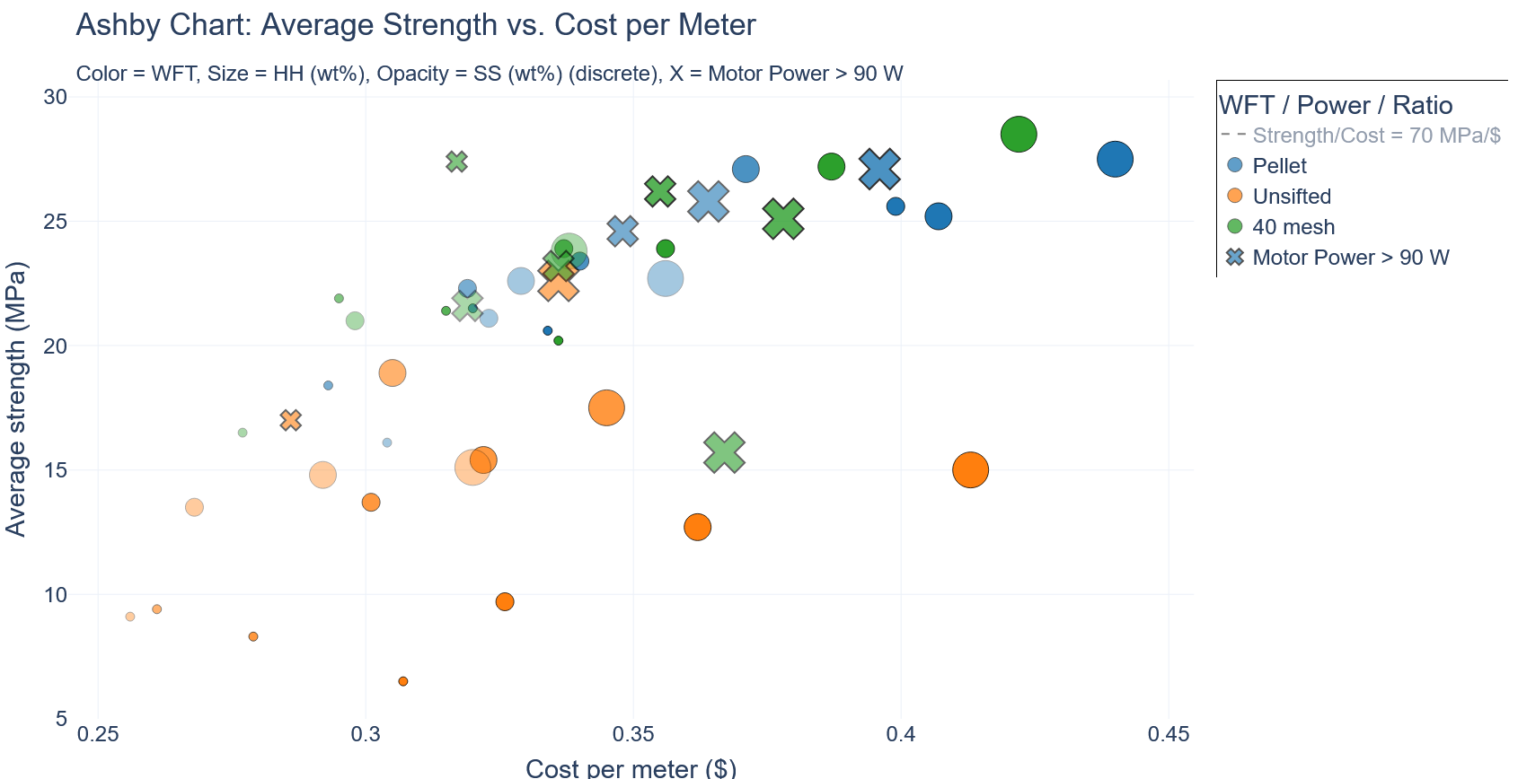
Strength-cost analysis for all formulations

Slide 31
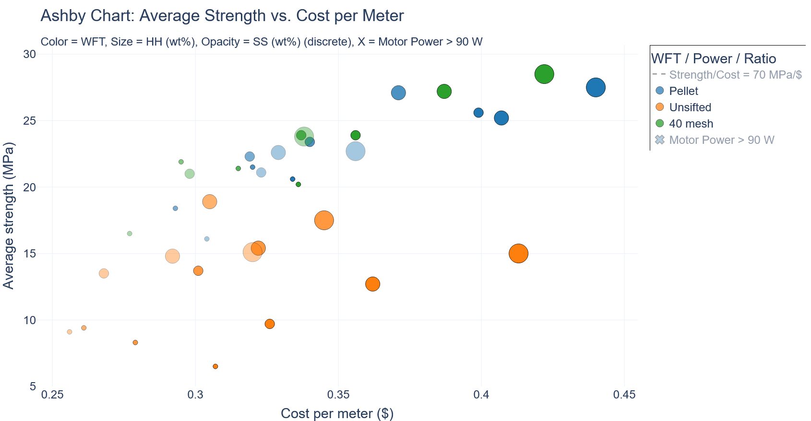
Strength-cost analysis, after formulations with high motor power are removed

Slide 32
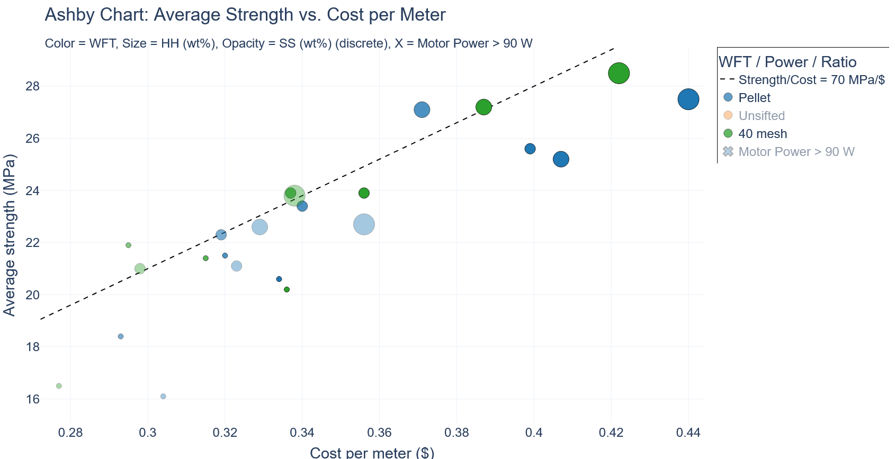
Strength-cost analysis for pellets and 40 mesh wood fibers

Slide 33
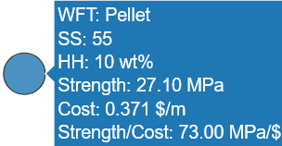
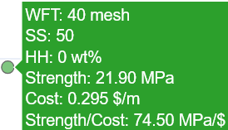
Two formulations showed high strength-to-cost ratio, with low motor power

Slide 34
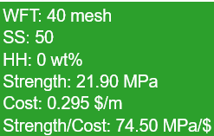
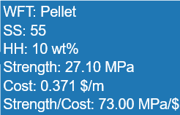
Pellet-formulation is stronger, but 40 mesh-formulation is lower cost

Slide 35
The pellet-formulation uses less sodium silicate than the 40 mesh-formulation, for the same strength
Strength/SS: 0.869 MPa/g
Strength/SS: 0.891 MPa/g

Slide 36
Pellets have a higher density than unpelleted wood fibers

Slide 37
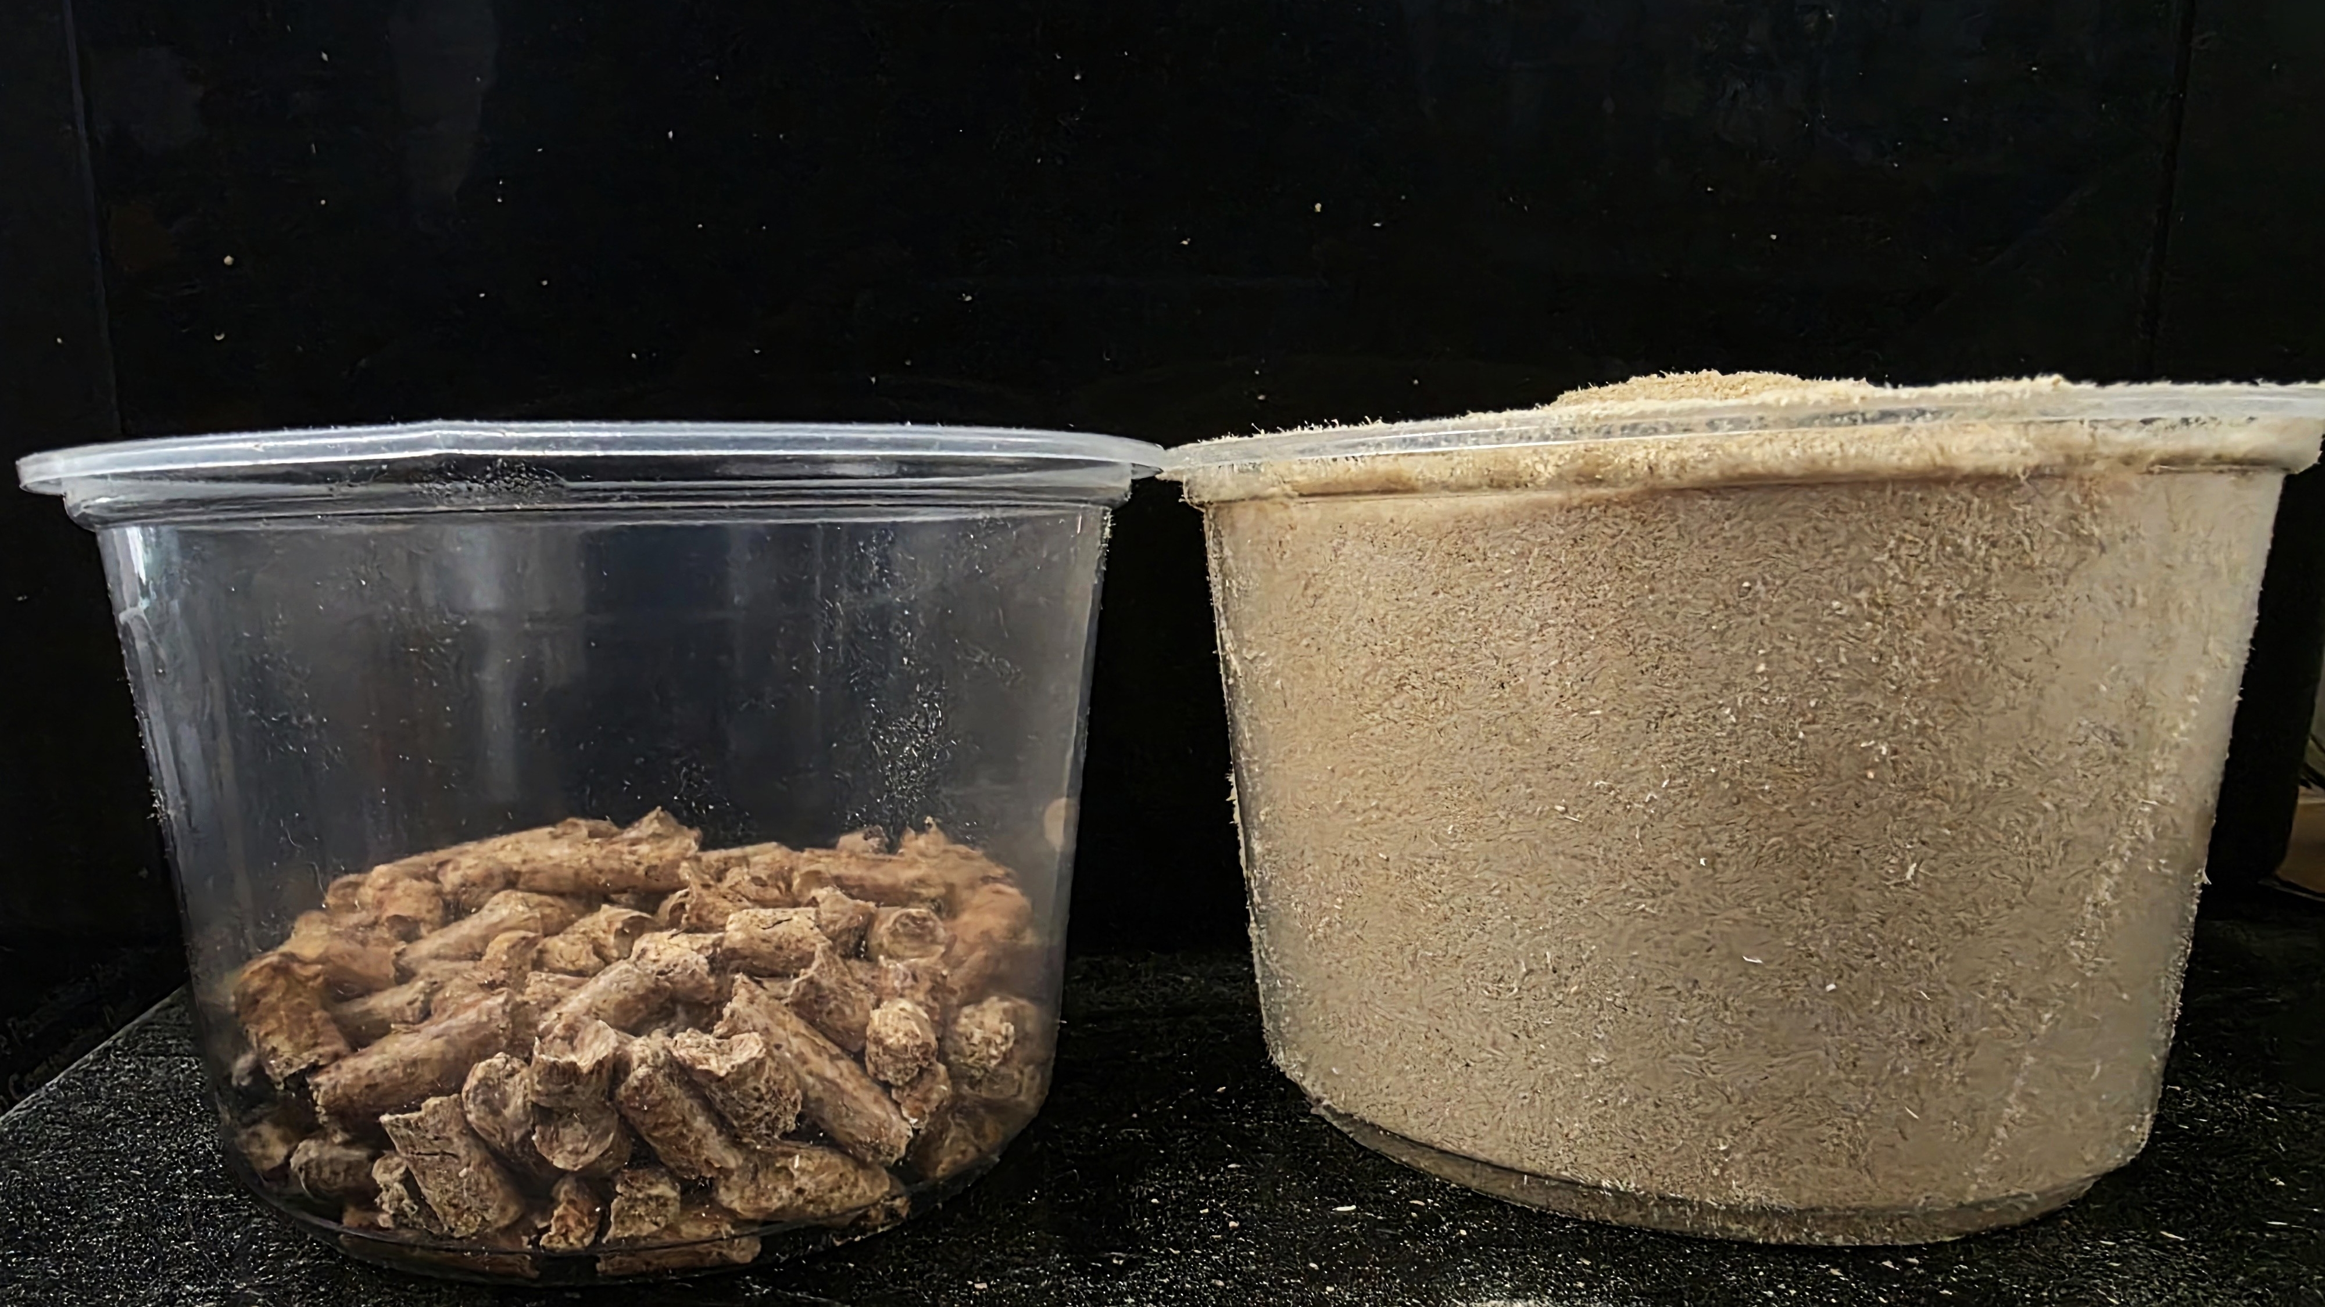
Pellets are preferable due to logistics

Slide 38
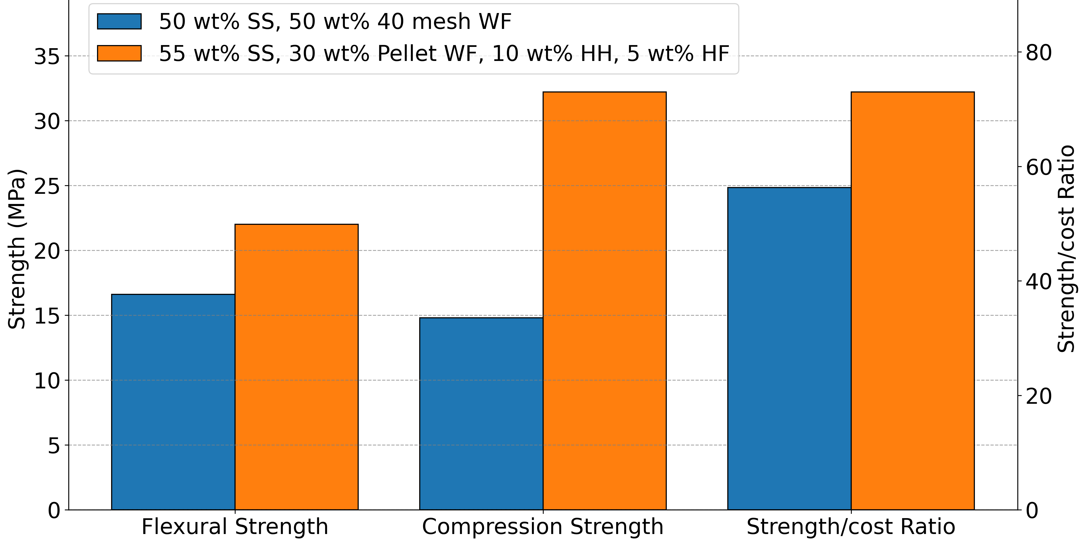
Optimization of the formulation with hemp fiber and hurd reinforcement, and wood pellets replacement
29%
118%
32%

Slide 39
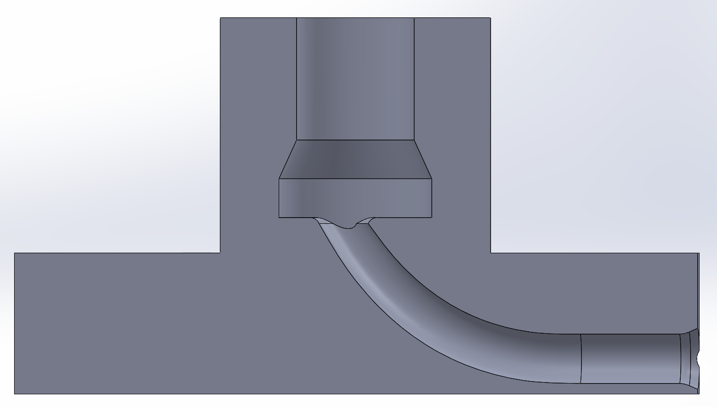
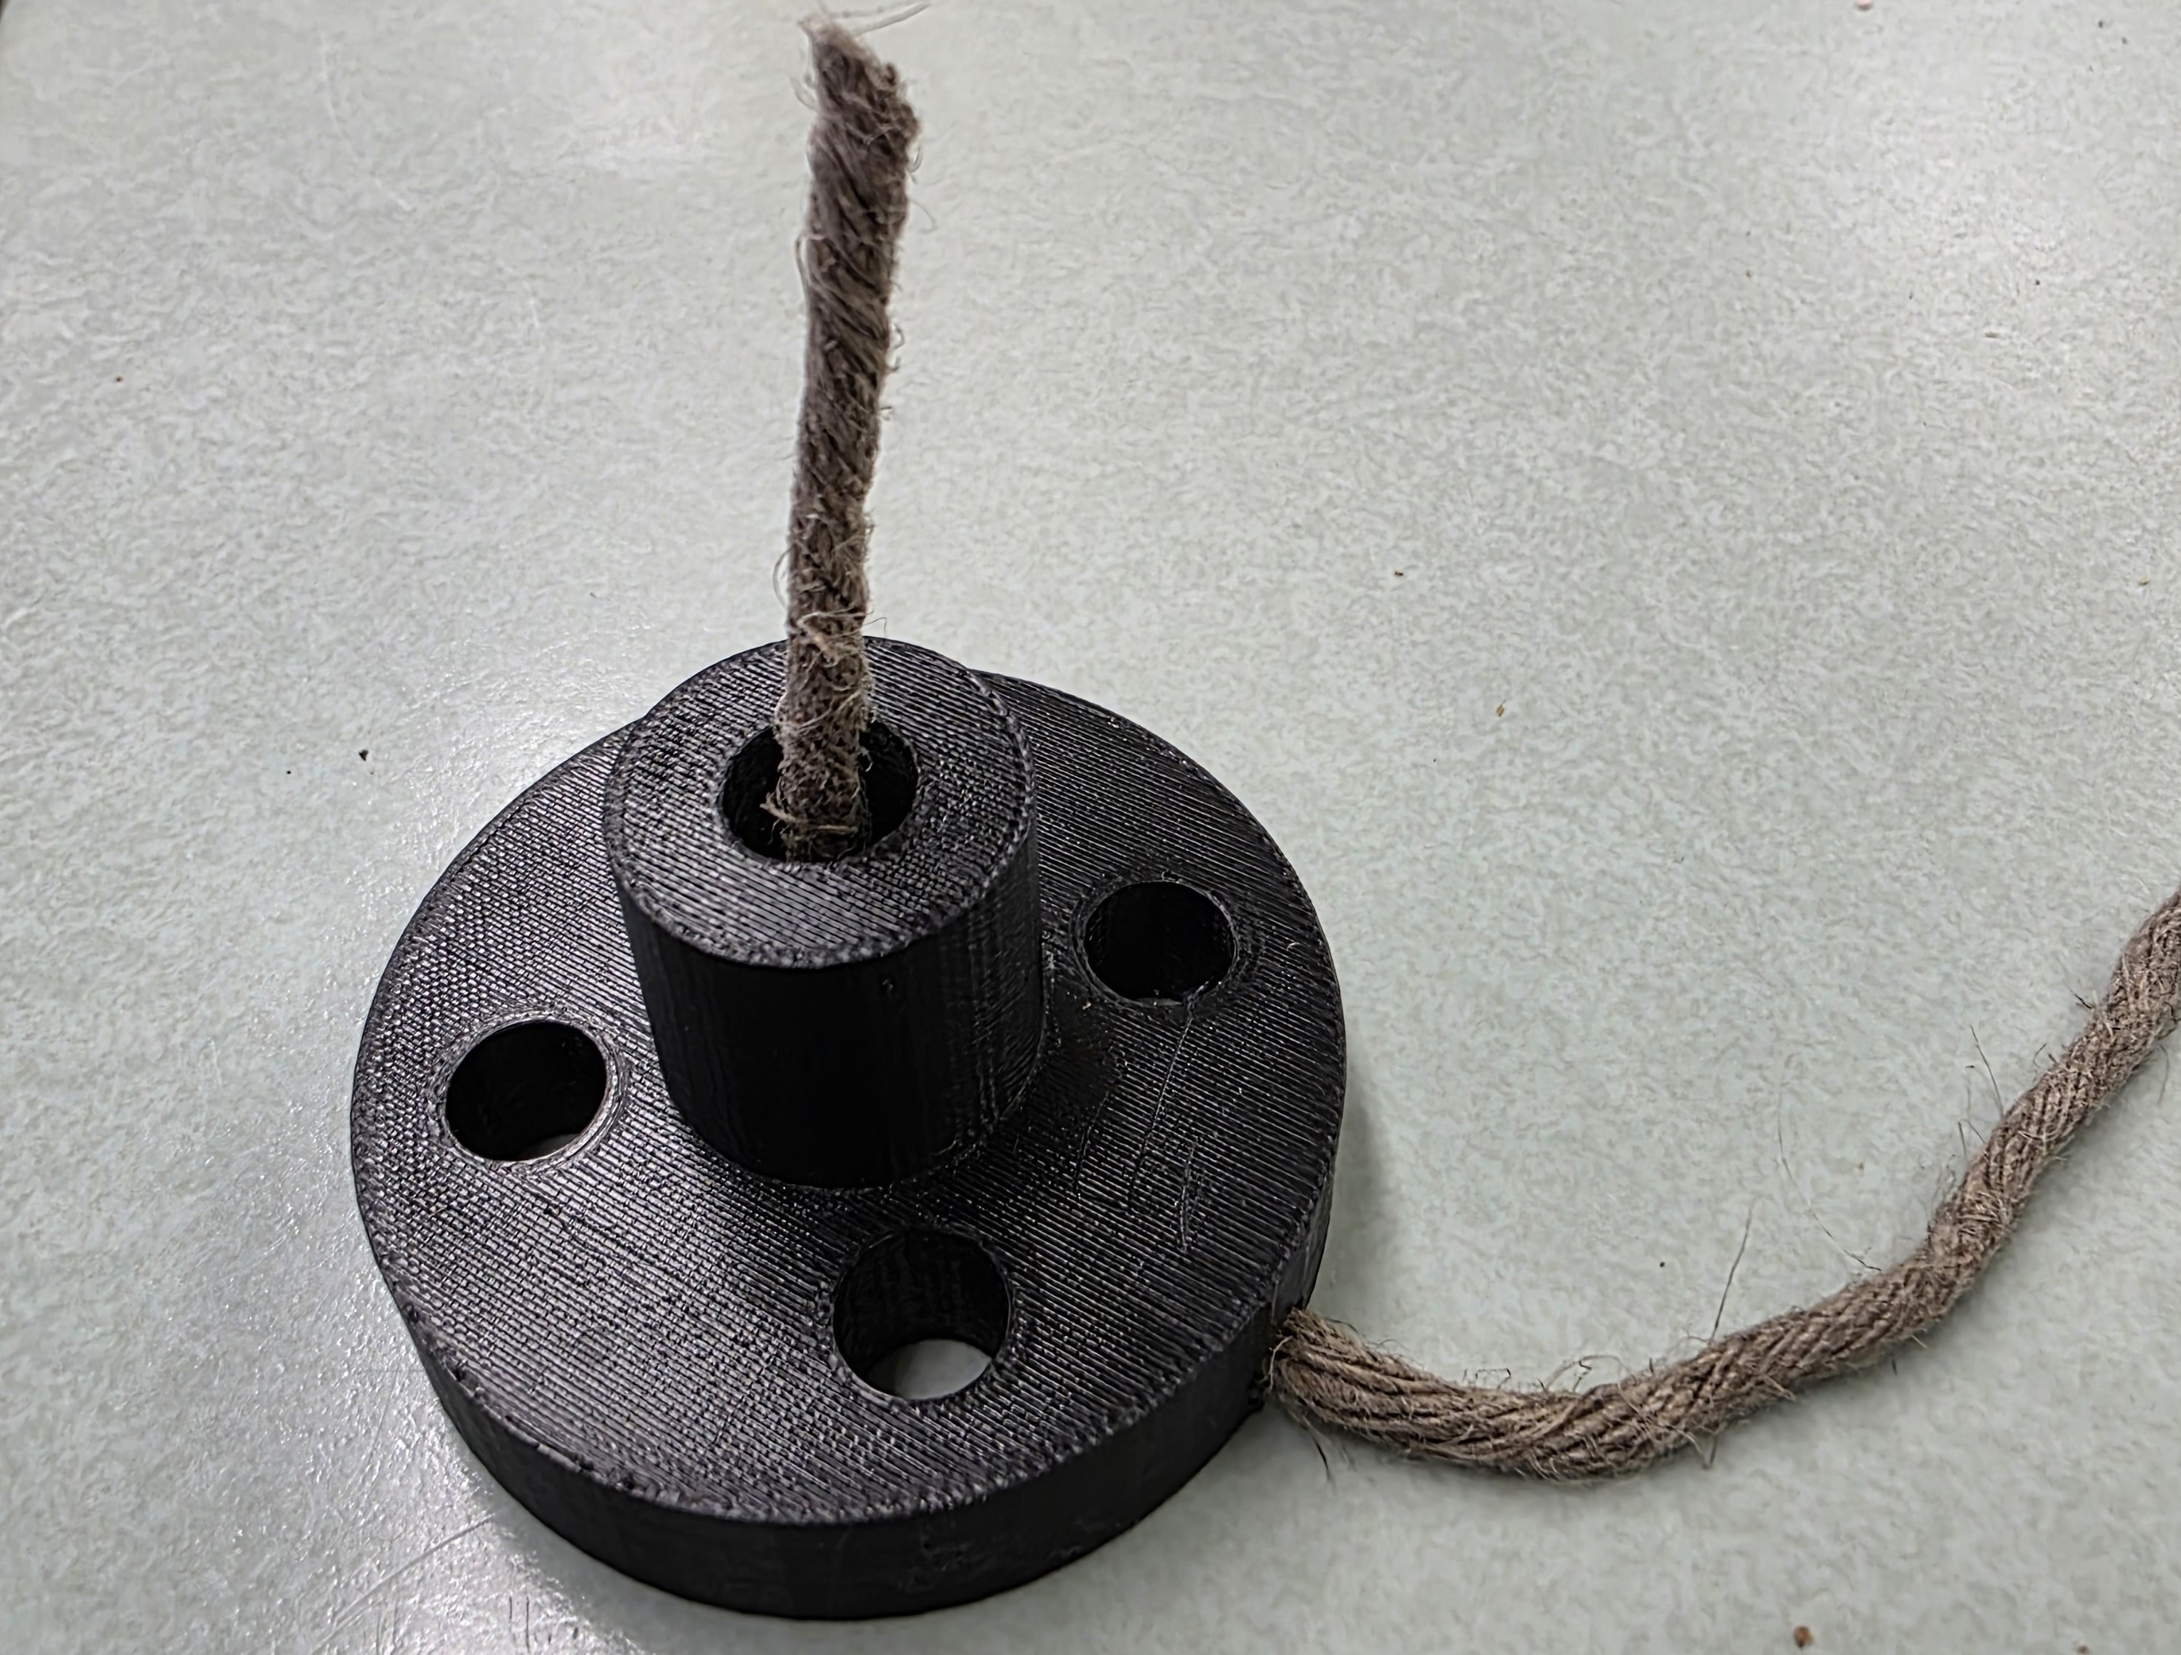
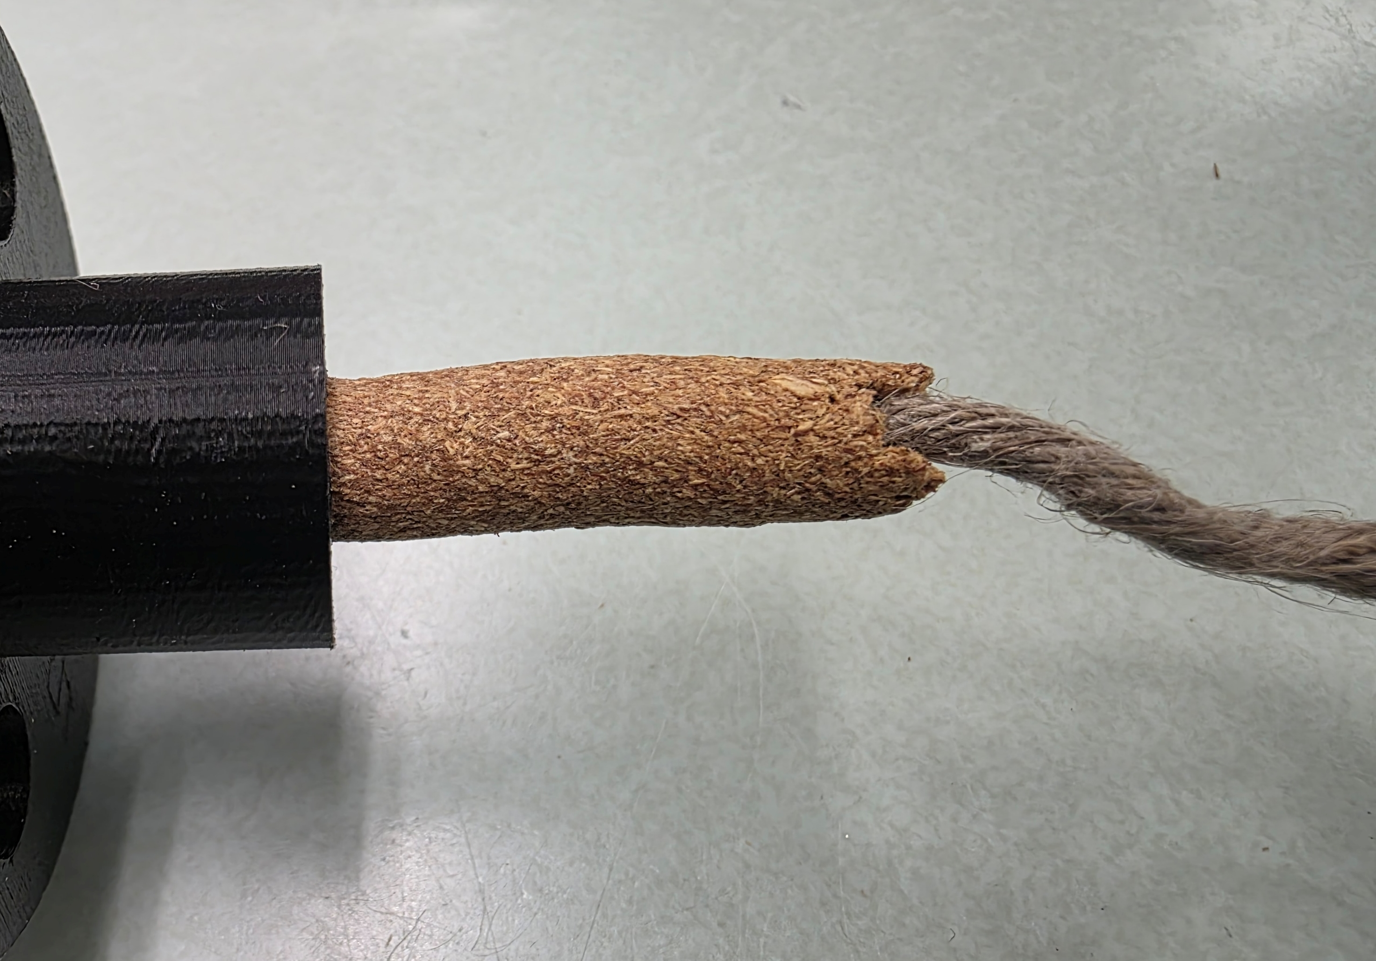
Study 3: Die modification for continuous fiber reinforcement

Slide 40
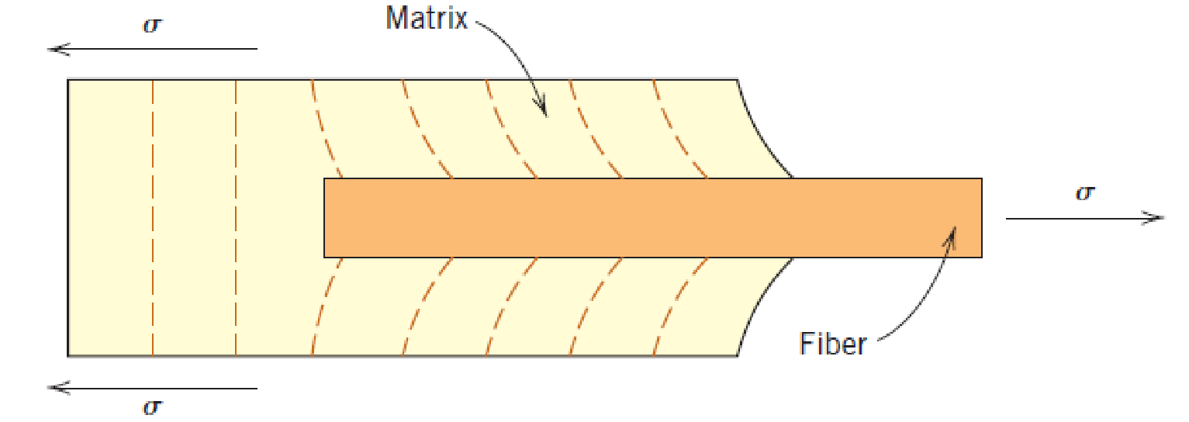
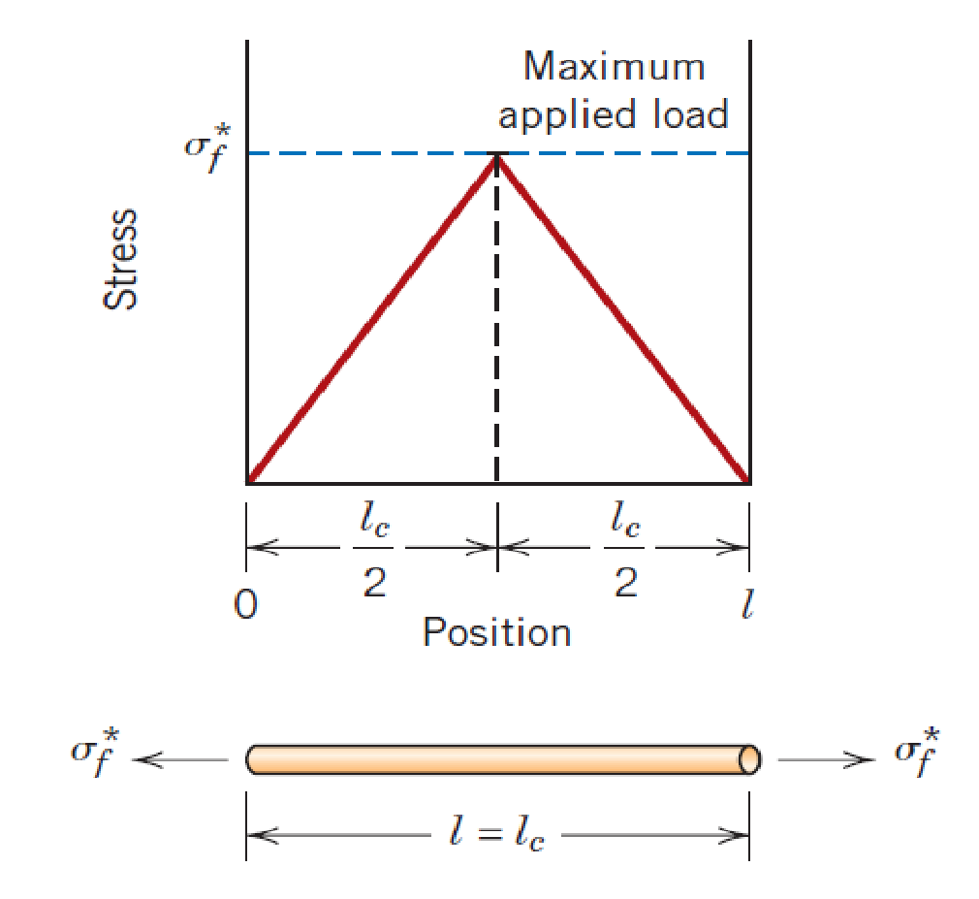
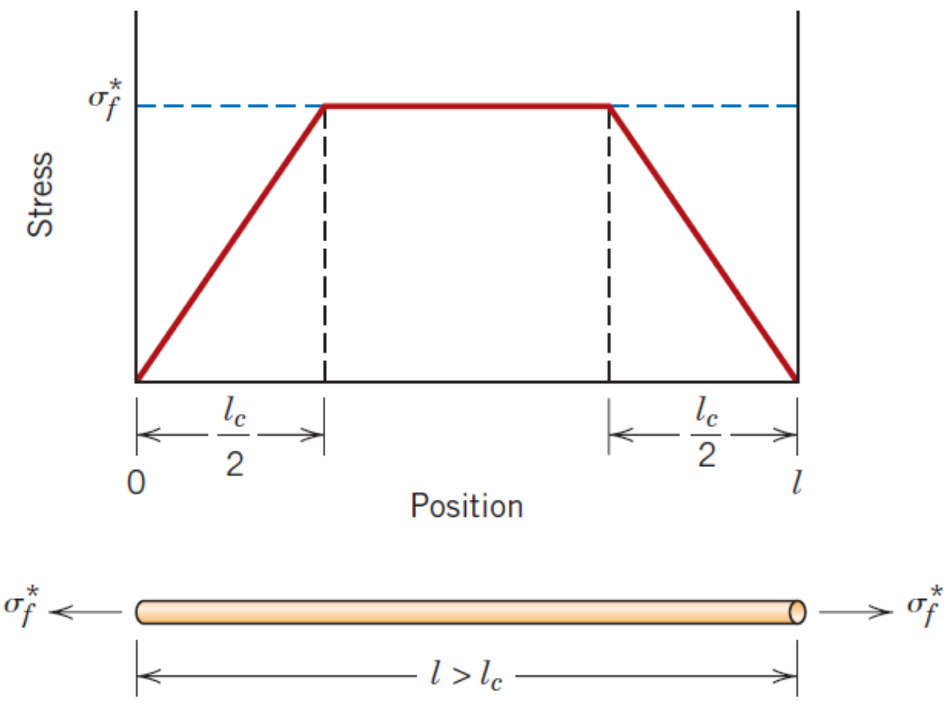
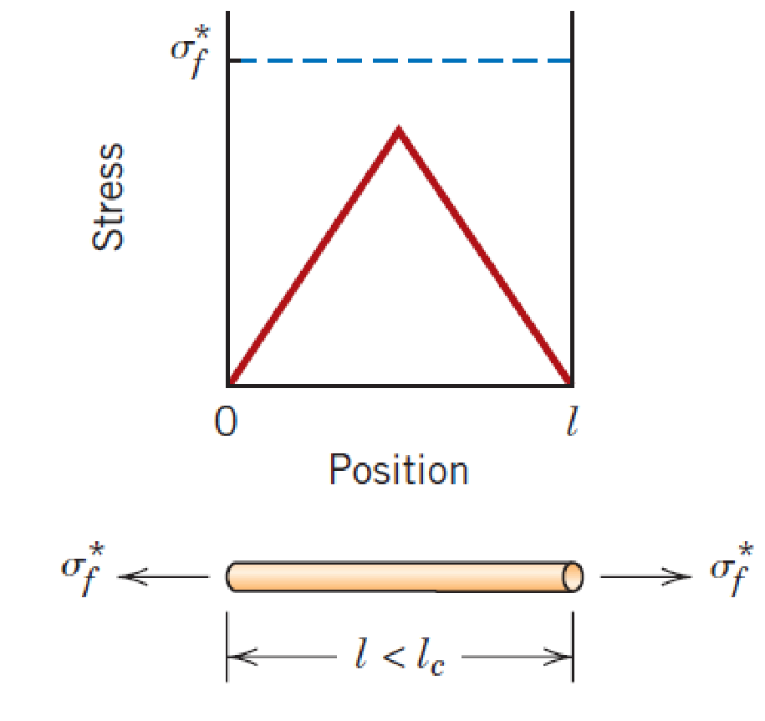
Critical length of a fiber is the length at which a fiber becomes maximally useful
https://doi.org/10.1088/1757-899X/508/1/012006

Slide 41
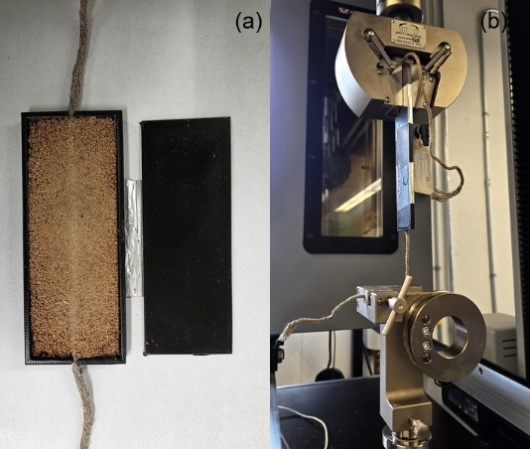
Interfacial shear stress and critical length were measured using single fiber pullout test
Three treatment conditions:
No treatment
Water
Sodium silicate

Slide 42
Interfacial shear stress and critical lengths were improved by sodium silicate treatment
Voids

Slide 43
Tensile strength of composite was 60% higher with sodium silicate treated fiber
60%

Slide 44
This dissertation improved the flexural, compression and tensile strength using multi-scale reinforcement
Increase in flexural, compression strengths by 75%, and strength/cost by 29%.
Novel method for continuous fiber reinforcement; increase in tensile strength by 60%, using 5 vol% hemp twine.

Slide 45
Future work
Testing in real world conditions.
Complete cost analysis, including equipment, labor to compare with lumber/concrete construction.
Further improvement in tensile strength using higher fiber fractions.
Alternative bio-based resins.
Questions?

